Slide 1
Hacking on Azure Websites
with Node.js and the Spotify Web API
@DanielLarsenNZ

Slide 2
This talk
Node.js on Azure Websites
Spotify Web API
Node.js + Express, Table Storage
WebJobs, Queue Storage

Slide 3
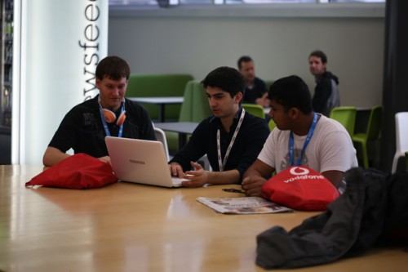

http://hackakl.org.nz/
Notes:
Hacking is: “The act of engaging in programming in a spirit of playfulness and exploration.
Hacker is: “A person who enjoys exploring the details of programmable systems and stretching their capabilities.
“Hacking entails some form of excellence, for example exploring the limits of what is possible, thereby doing something exciting and meaningful.

Slide 4
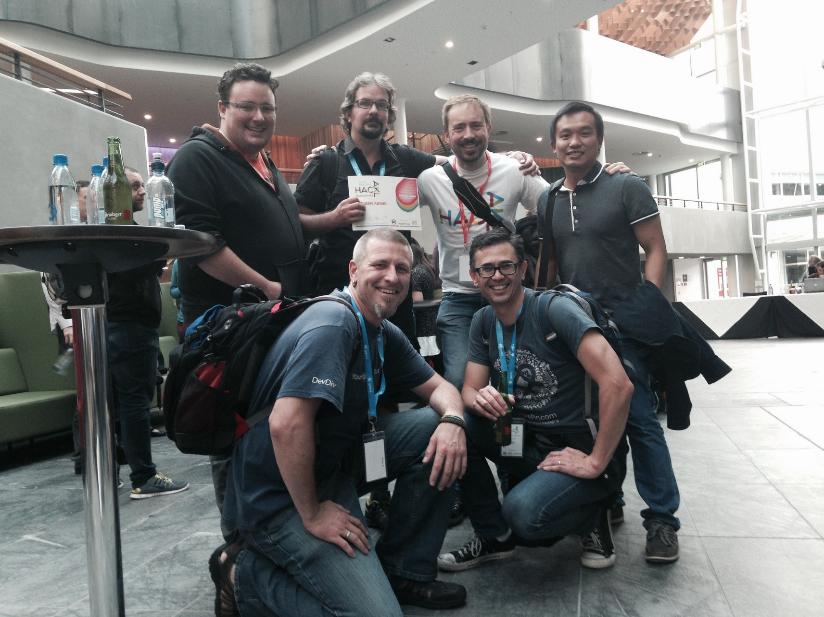

Slide 5
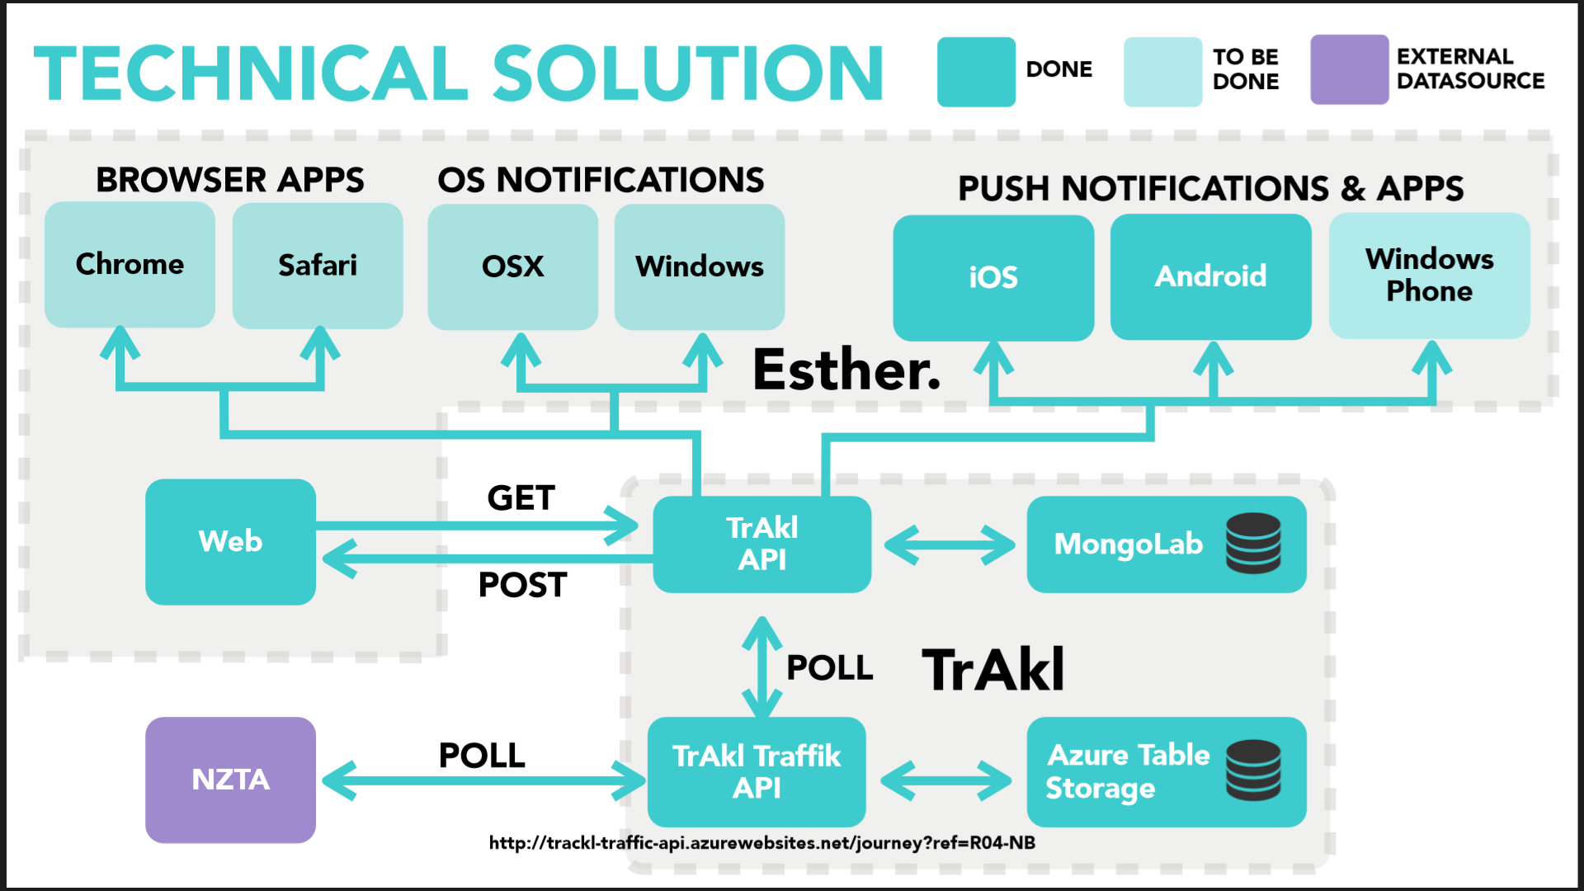

Slide 6
Node.js on Azure Websites
Azure Website Instance
IIS
iisnode
Node.exe
JS
Modules

Slide 7
Node.js in Visual Studio
Visual Studio 2013 Update 3
All editions including Express!
Visual Studio 2012 Update 4
Pro edition +
Web Essentials (optional)
Node Tools for Visual Studio (NTVS) 1.0 beta 2

Slide 8
Demo
Node.js + NTVS + Azure Websites

Slide 9
Spotify Web API
https://developer.spotify.com

Slide 10
Demos
https://developer.spotify.com/web-api/
http://music.xbox.com/Developer
http://lab.possan.se/thirtify

Slide 11
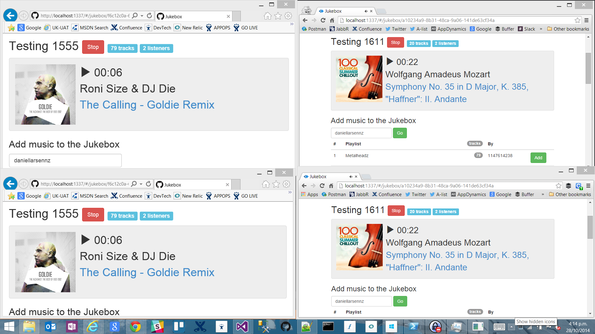
http://jukebox30.azurewebsites.net

Slide 12
Feature map
Feature | Stories
Jukeboxes | Create | List | Get/View
Playlists | Get | Import Tracks
Player | Start | Stop | View meta-data

Slide 13
Architecture
Browser
Azure Storage
Bootstrap
Queue Storage
Azure Website
Angular.js
express
socket.io
socket.io
Table Storage
Node.js
iisnode
WebJobs
Spotify Web API

Slide 14
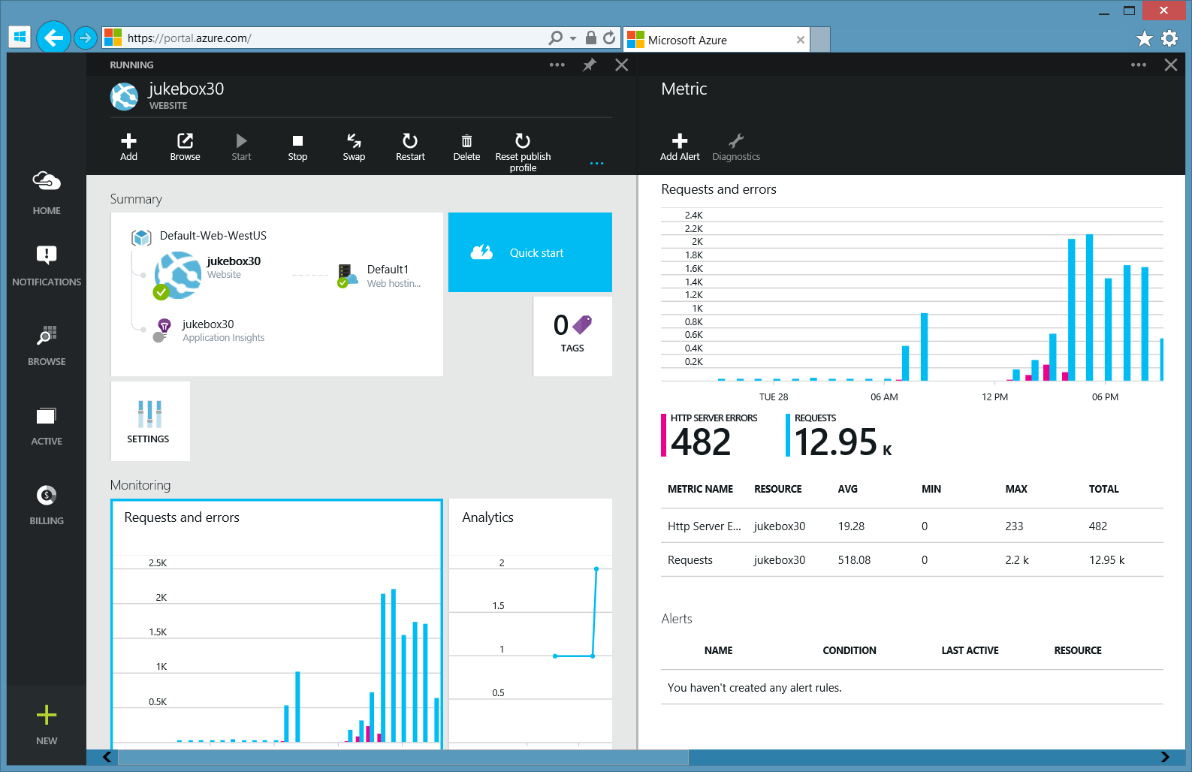
(The new) Azure Portal
Streaming logs
Console
Webtests
Monaco
Test on Prod
Webjobs
…

Slide 15
Azure Queue Storage, WebJobs

Slide 16
Queue pattern
API has most contention
Message Queue
Node.js + express
Enqueue is fast
Queue Storage
UI clients demand quick response
Dequeue < 1 minute
Table Storage
WebJob
C# EXE
Spotify API

Slide 17
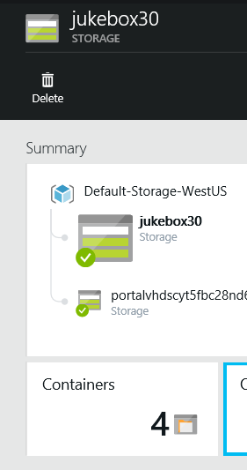
Azure Queue Storage
Simple REST API. APIs for Node.js, .NET.
Message is string up to 64KB in size.
Almost unlimited Queue size (~200TB /queue)
Geo/Zone/Local redundancy
You must request (poll) to de-queue
Cheap
Consider Azure ServiceBus if you need instant notification, guaranteed delivery, FIFO, etc.

Slide 18
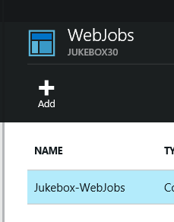
WebJobs
Simple jobs that can run continuously or to a schedule.
Jobs can be EXEs, .JS and more.
Can run in same Azure Website instance as App (sharing same resources) or in a standalone Azure Website.
Continuous requires “Always On”, requires Basic or Standard plan.
WebJobs SDK is a .NET library that simplifies Queue polling, poison message handling, etc.

Slide 19
Azure WebJobs, Queue Storage
Walkthrough

Slide 20
Node.js, Express, Table Storage
Walkthrough

Slide 21
Recapping
Node.js on Azure Websites
Spotify Web API
Node.js + Express, Table Storage
WebJobs, Queue Storage

Slide 22
Questions?
Daniel Larsen
@DanielLarsenNZ
https://github.com/DanielLarsenNZ/Hacking-on-Azure

Slide 23
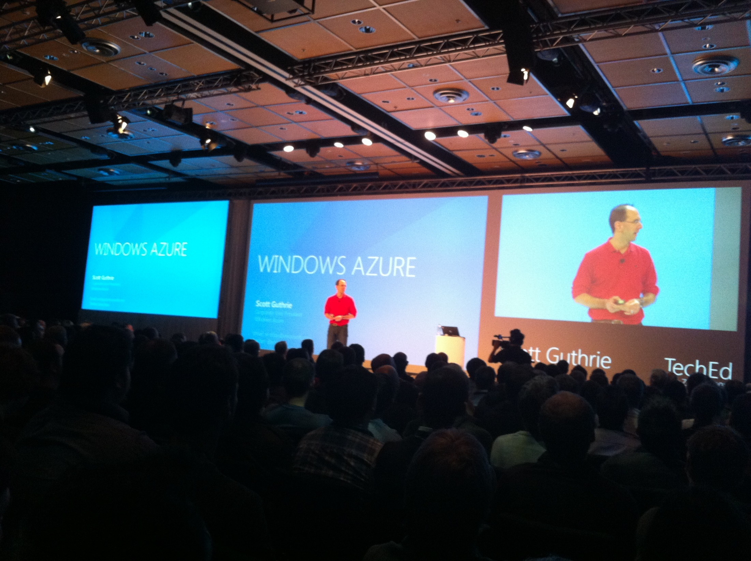

Slide 24
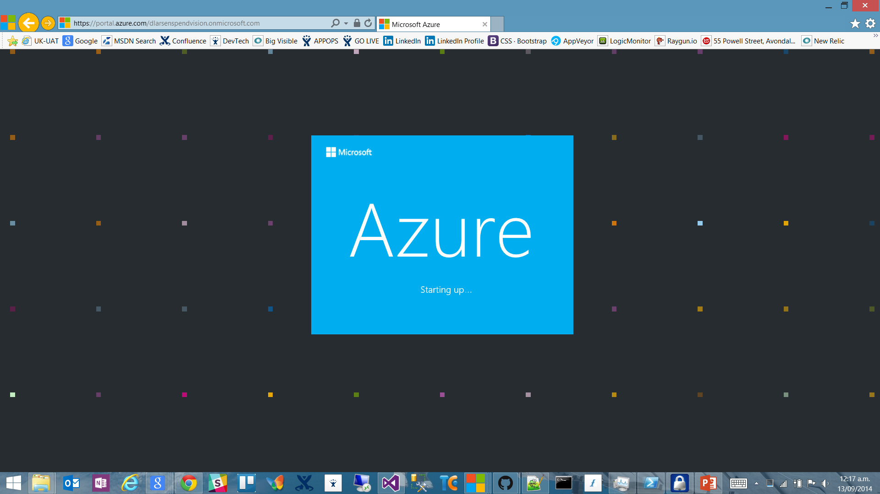

Slide 25
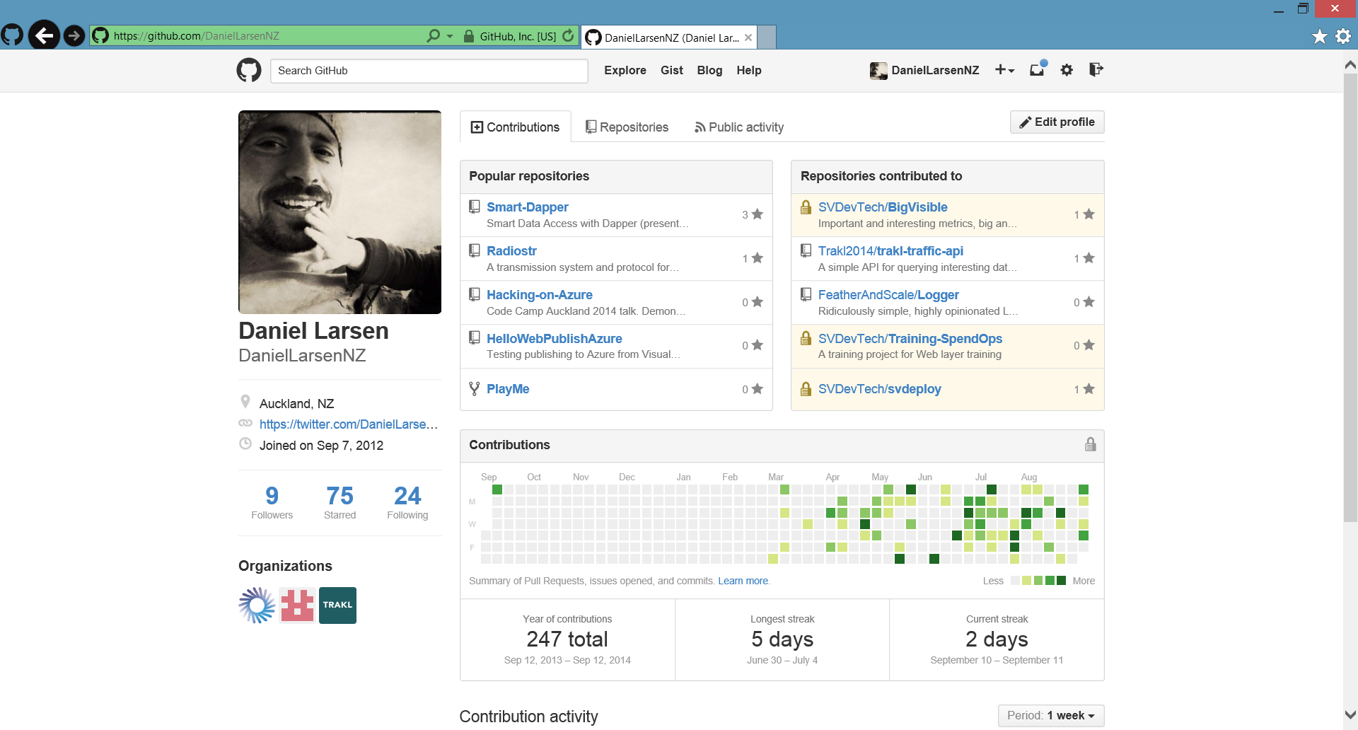

Slide 26
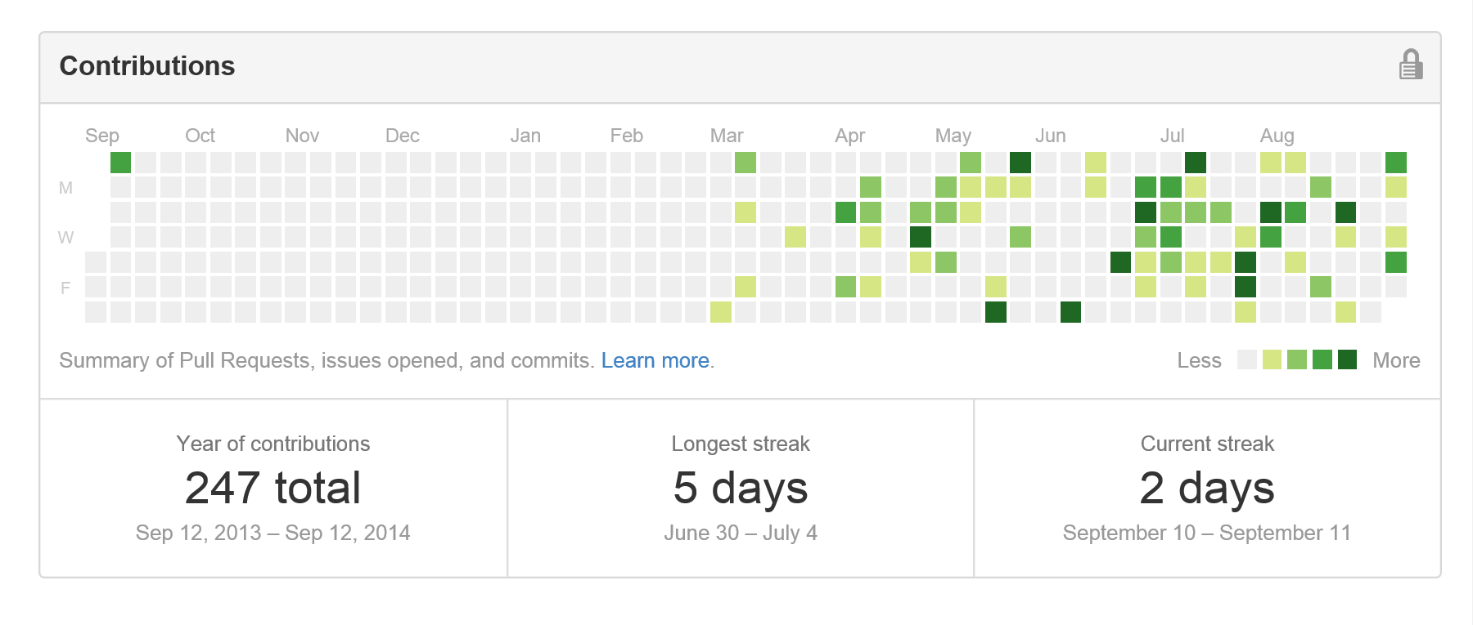
Contribution addiction

Slide 27
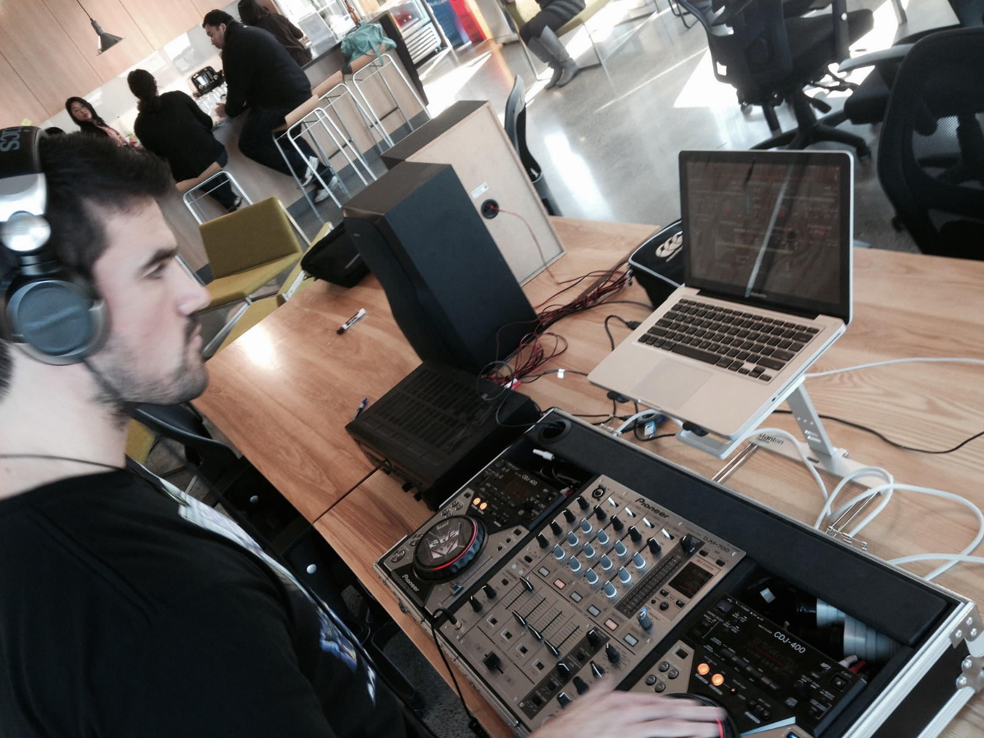

Slide 28
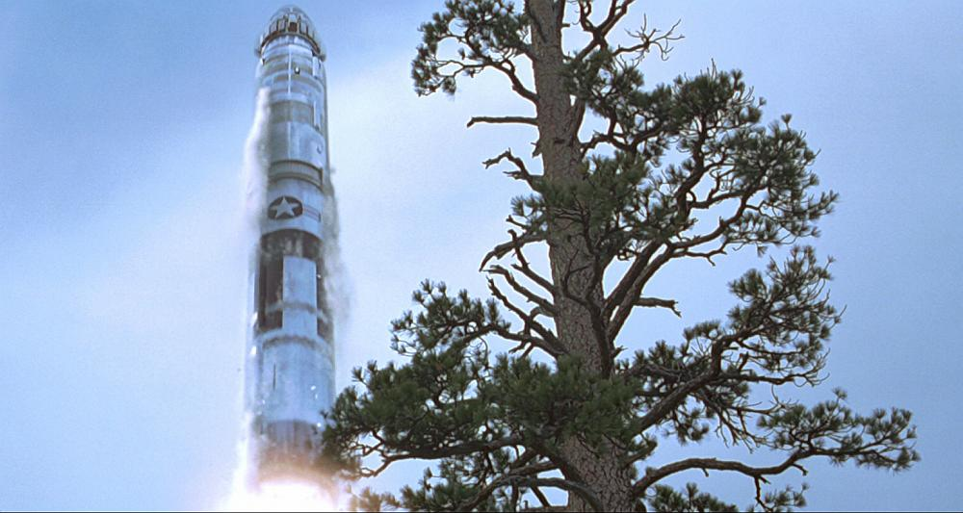
http://en.memory-alpha.org/wiki/Phoenix

Slide 29
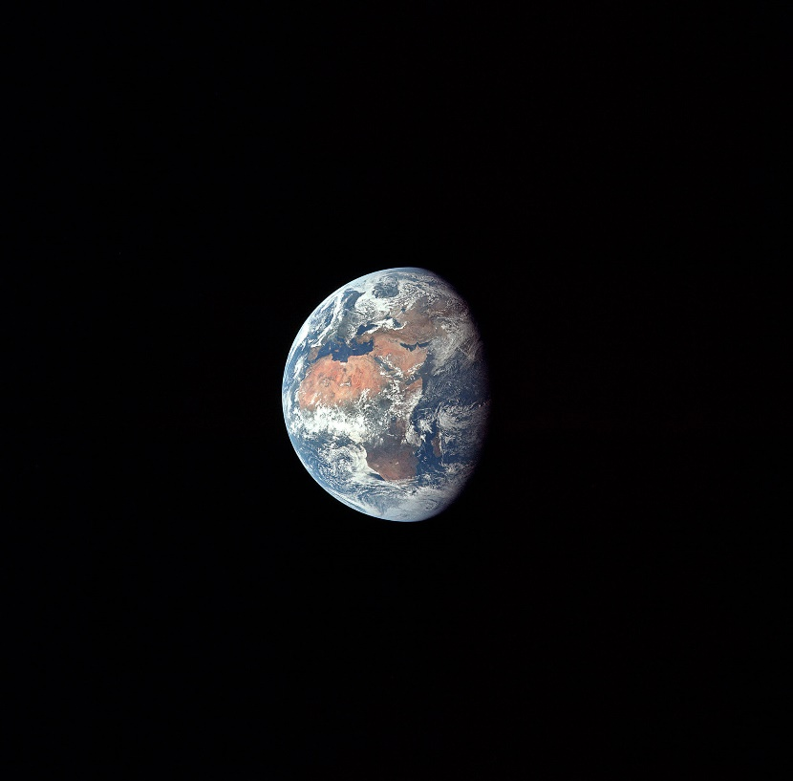
By NASA [Public domain], via Wikimedia Commons http://commons.wikimedia.org/wiki/File%3AApollo_11_Earth.jpg

Slide 30
Hacking
(This is not a Security talk)

Slide 31
Hacking is exploration
“The act of engaging in programming in a spirit of playfulness and exploration.
http://en.wikipedia.org/wiki/Hacker_(programmer_subculture)

Slide 32
Hacker enjoys exploring
“A person who enjoys exploring the details of programmable systems and stretching their capabilities.
http://en.wikipedia.org/wiki/Hacker_(programmer_subculture)

Slide 33
What is possible?
“Hacking entails some form of excellence, for example exploring the limits of what is possible, thereby doing something exciting and meaningful.
http://en.wikipedia.org/wiki/Hacker_(programmer_subculture)

Slide 34
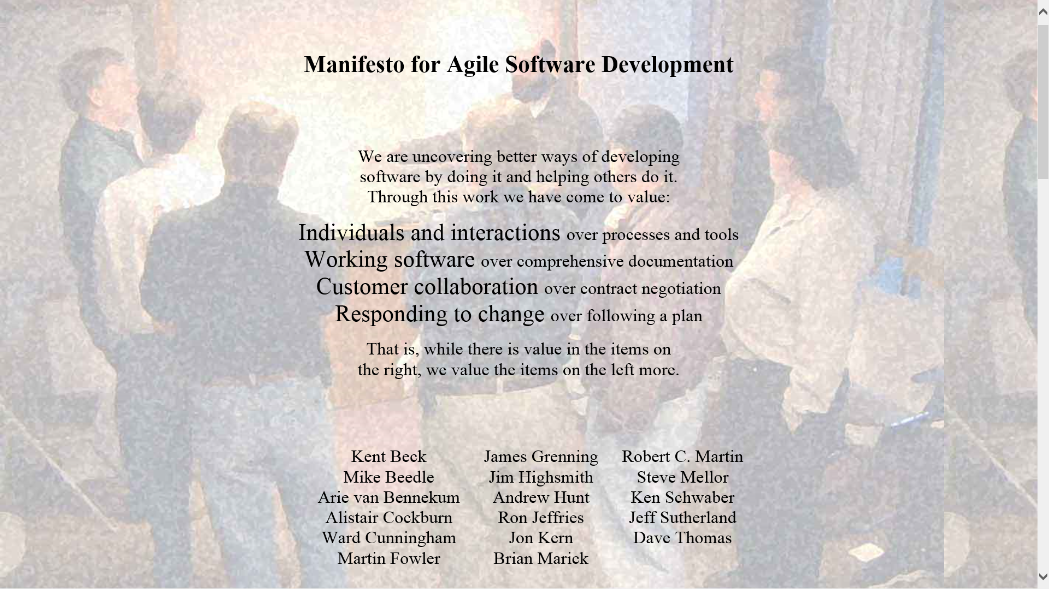

Slide 35
Architecture phase 1
Browser client (Angular.js)
Azure Website
(Node.js)
Spotify Web API
Queue Storage

Slide 36
What I didn’t talk about
New Relic
Newman
GitHub deploy
Kudu
Edge.js
CoreCLR, OWIN, Density
Azure costs
Visual Studio Monaco
Lean

Slide 38
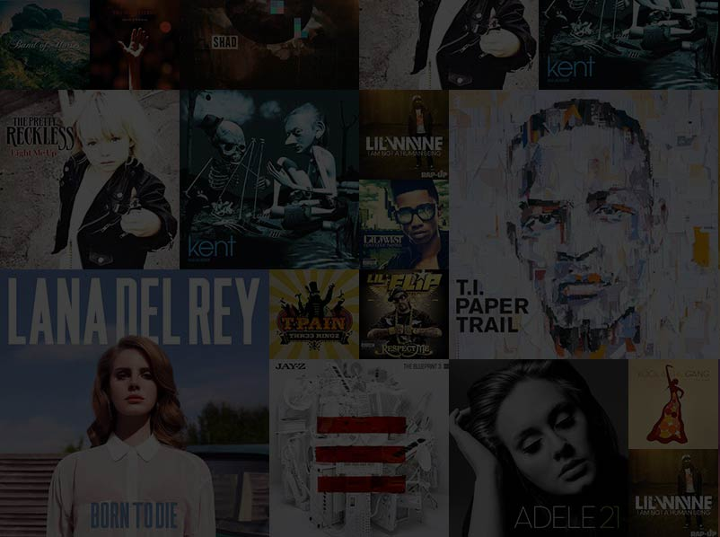

Slide 39
http://en.memory-alpha.org/wiki/Phoenix

Slide 40
By NASA [Public domain], via Wikimedia Commons http://commons.wikimedia.org/wiki/File%3AApollo_11_Earth.jpg

